Slide 1
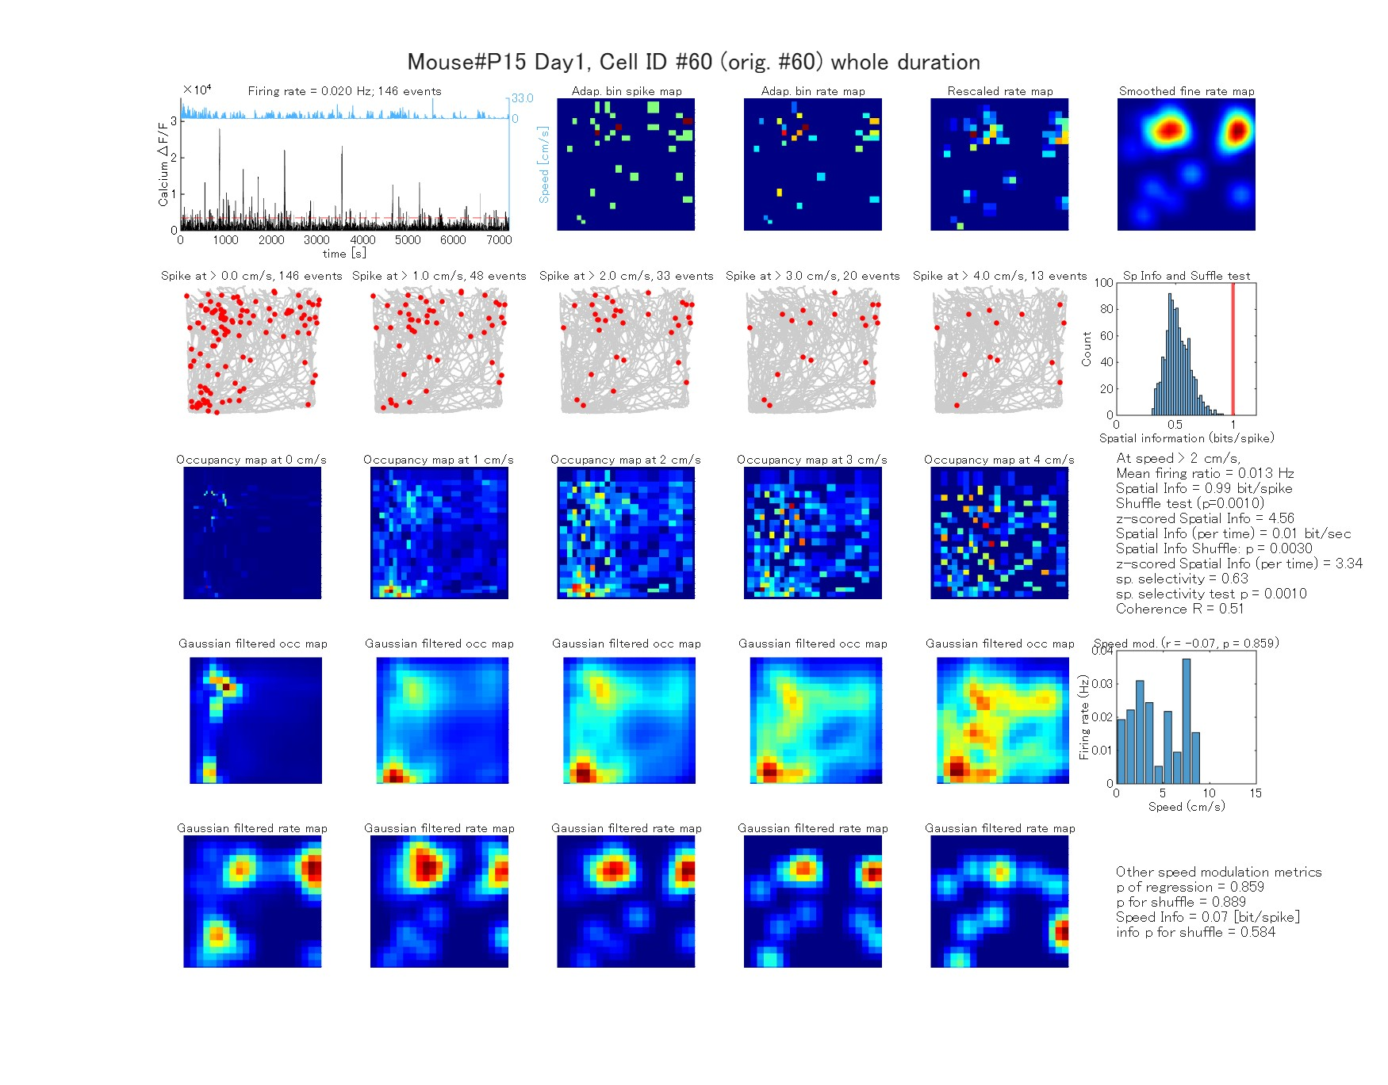
Expected Outcome 1 from Analysis_260204_seq_6MAD_AdaptiveBin.m
Rate-map and spatial information analysis
Animal speed
Spike map
Rate map
Rescaled rate map
Fine rate map
Calcium trace
Animal trajectory at and spike events at each speed
Spatial info. vs. shuffle
Original occupancy map
Gaussian filtered occupancy map
Speed modulation
Gaussian filtered rate map

Slide 2
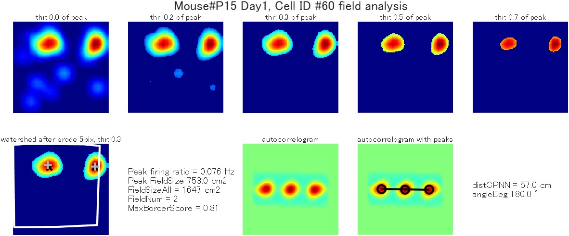
Expected Outcome 2 from Analysis_260204_seq_6MAD_AdaptiveBin.m
Place field related analysis

Slide 3
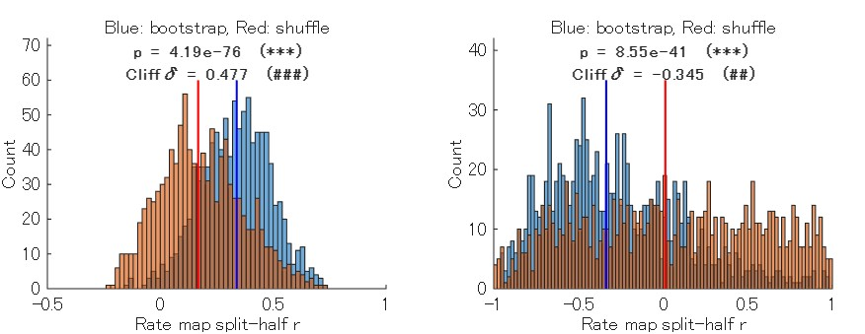
Expected Outcome 3 from Analysis_260204_seq_6MAD_AdaptiveBin.m
Rate-map reliability analysis

Slide 4
Expected Outcome from Fig_Bayesian_260525.m

